Slide 1
Module 1.5:
ML in Python
Python Env for Machine Learning
ML for Cybersecurity
Notes:
Hi everyone, welcome back to machin learning for cybersecurity. I'm yuxin, and in this video, we are goning to walk through how to setup python environment for machine learning.
This is going to come in handy for the sync session, where we are going walk through some python exerciese togethr, either indivudually or in group, to give you some hands on experiences in applying maching learning to the cyber security context.
Matt/Laura:
The plan is still to set up a JupyterHub instance for learners so that they can do these labs in the cloud without installing anything locally—but you might want to mention the pros and cons of working in the cloud vs installing Python locally, or why they might want to do the latter even if the former is an option.

Slide 2
Hardware and Software Preparation
You will need a laptop to get the most of the session, with Python (3.7 or higher) installed, along with numpy, scipy, sklearn, and (in later modules, tensorflow).
You also need to have the Jupyter Notebook or JupyterLab installed
Notes:
So, to get the most from the synchronous session, you will need to have a laptop or a desktop, with Python installed. We recommend you to install python version 3.7 or higher, along with the essential math, scientific comupting, machine learning packages and visualization tools, including numpy, scipy, sklearn, matplotlib, and tensorflow.
We will use the jupyter notebook or jupyter lab as the main interactive python interface.

Slide 3
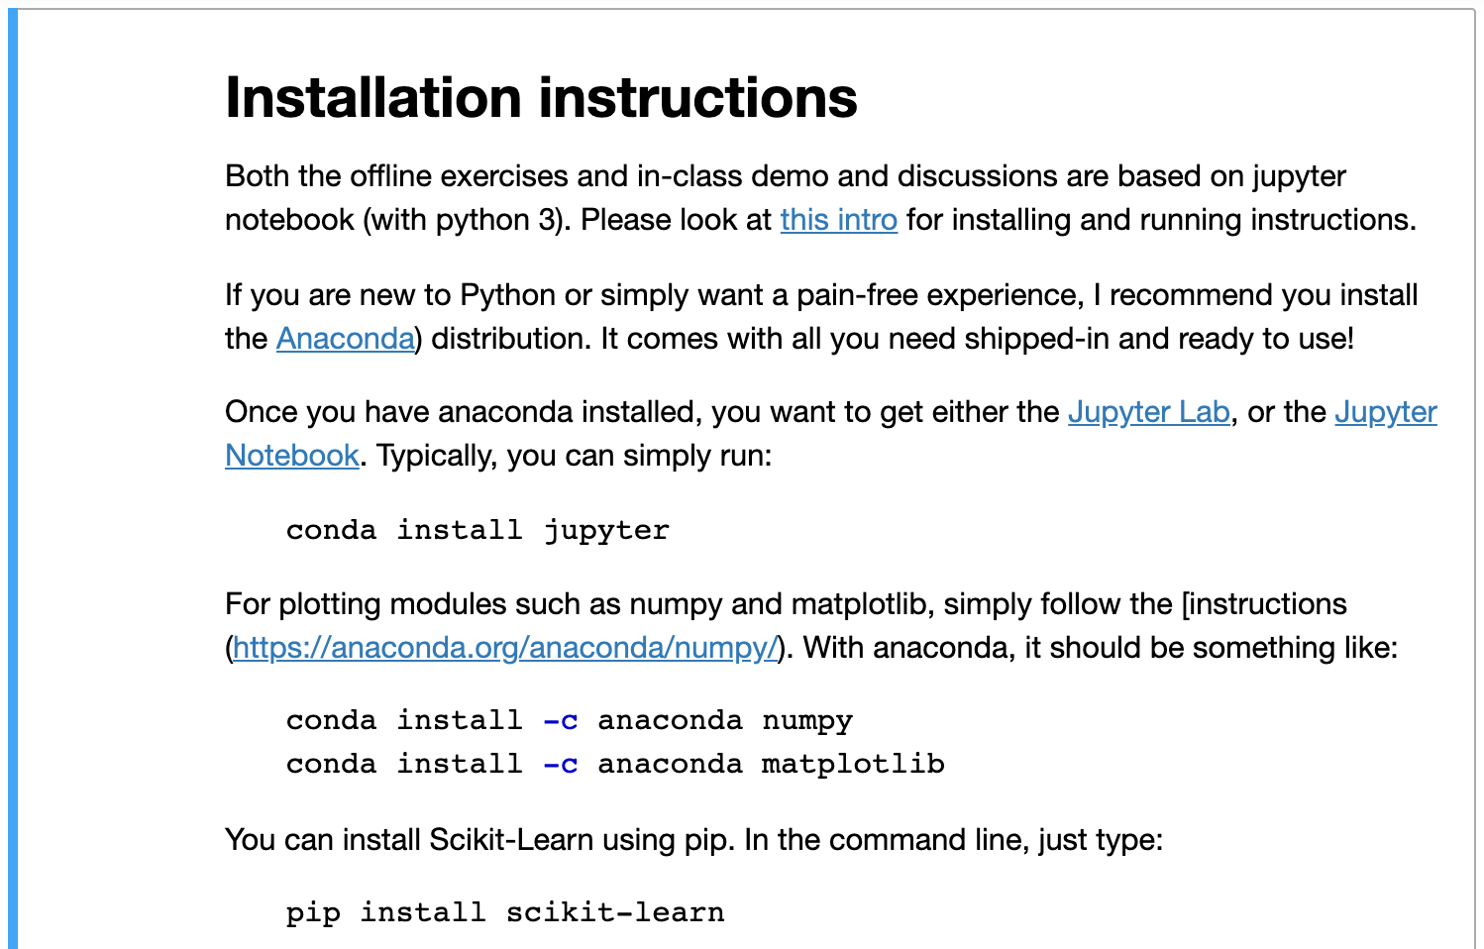
Notes:
And if you are new to python and are unsure about which package to install, I recommend you to install the anaconda distribution. You can follow the commandline on the screen, and install Jupyter, numpy, etc.
Another option is to install scikit learn using the pip command. Pip comes with the installation of Python 3, so things should work as long as you have python installed.

Slide 4
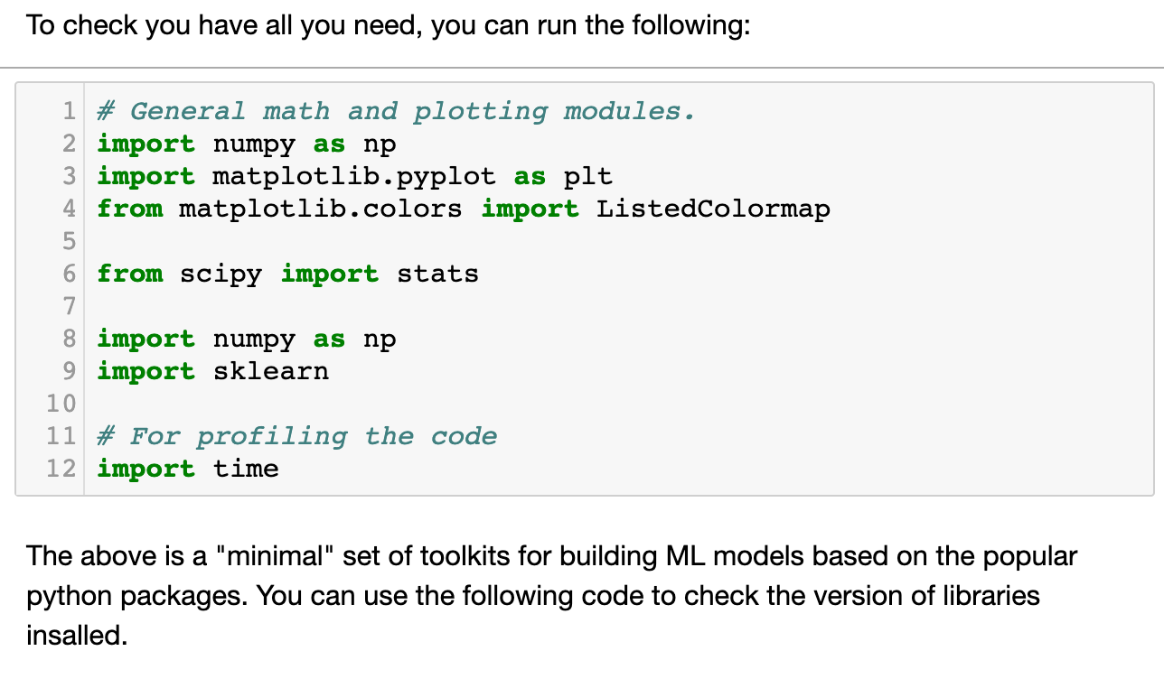
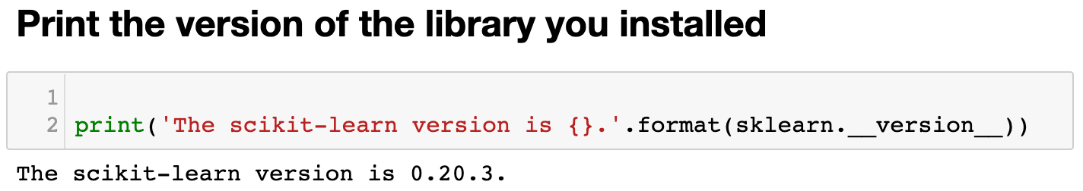
Notes:
Once you have jupyter notebook/lab installed, just open jupyter lab from command line, a window will pop up in your brower, and you will navigate to the repository of your code.
Then open a cell, and type in the command as shown on the screen, to import the packages you've installed,

Slide 5
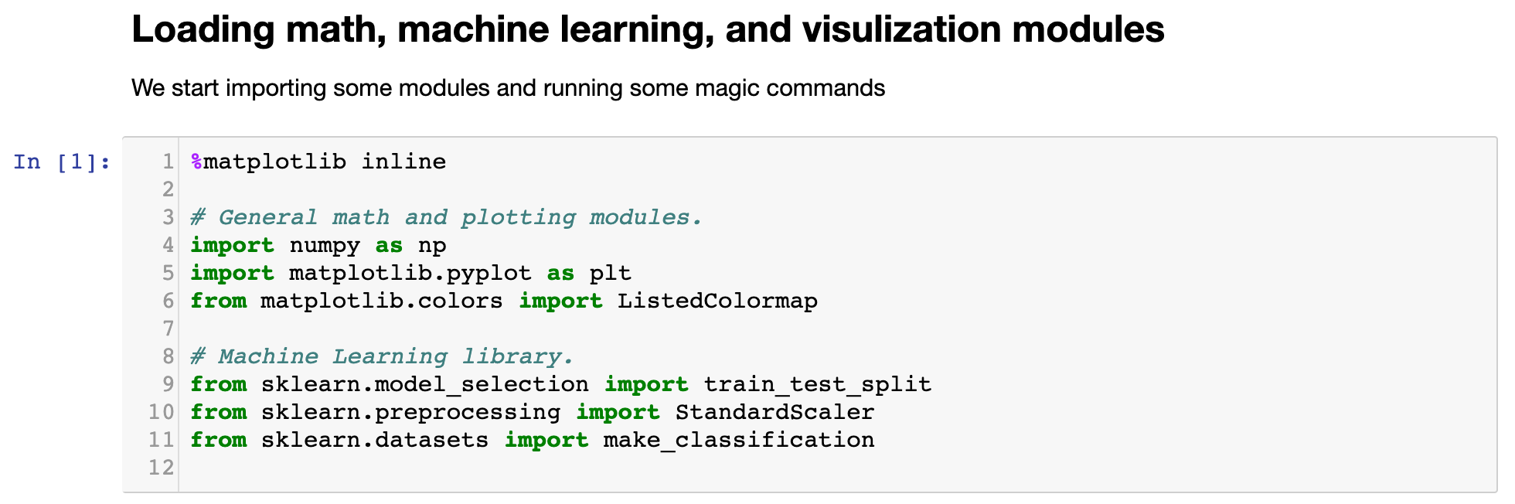
Demo of a Simple ML Pipeline: Load Libraries

Slide 6
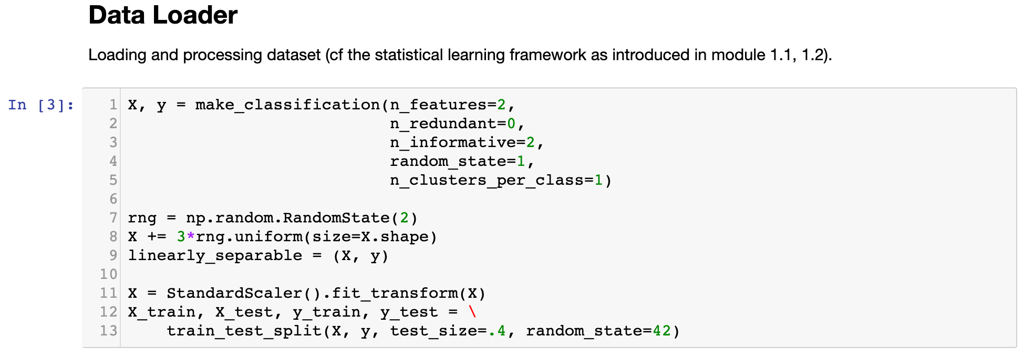
Demo of a Simple ML Pipeline: Loading Data

Slide 7
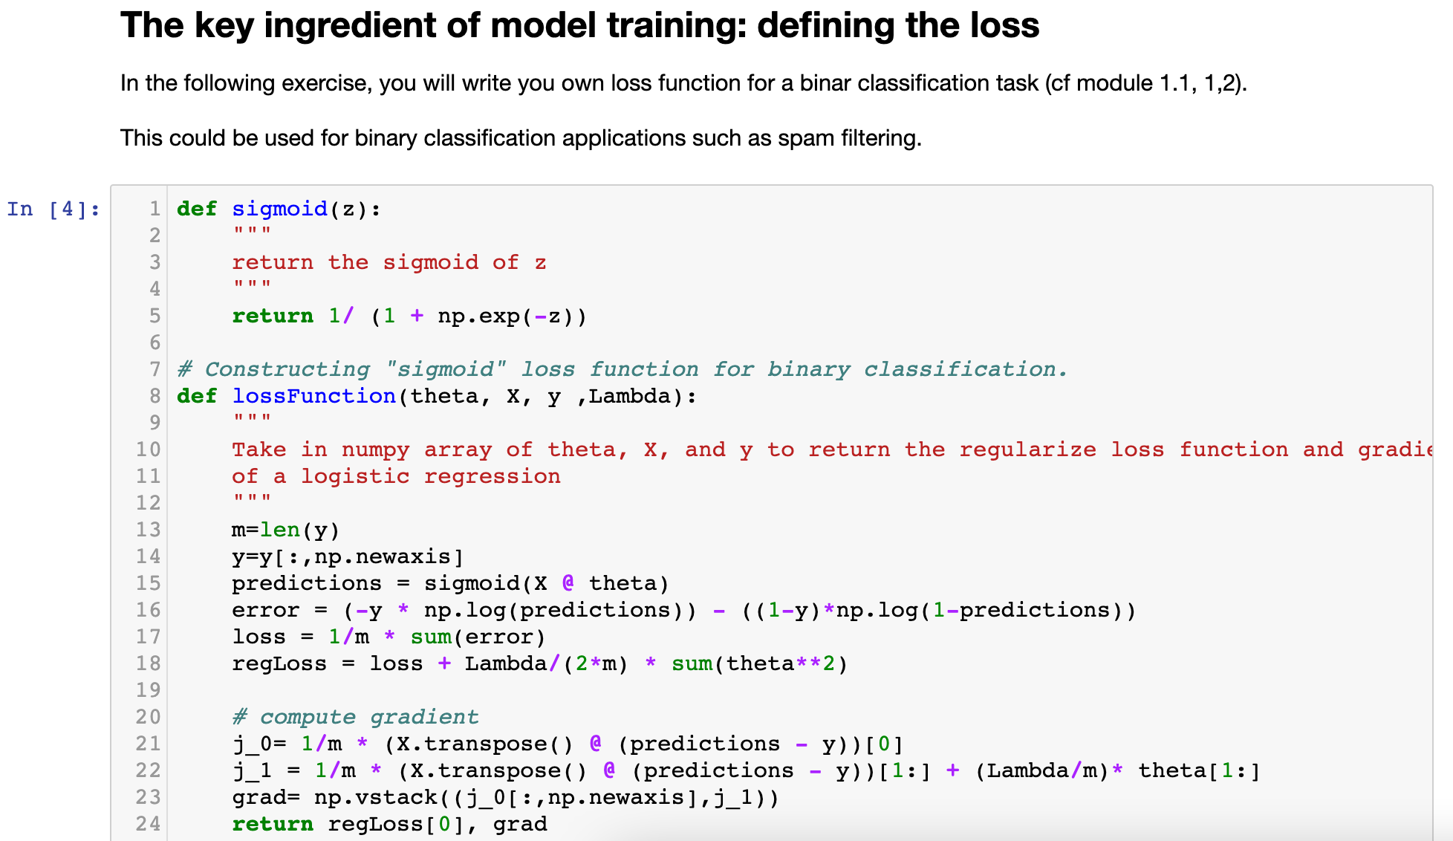

Slide 8
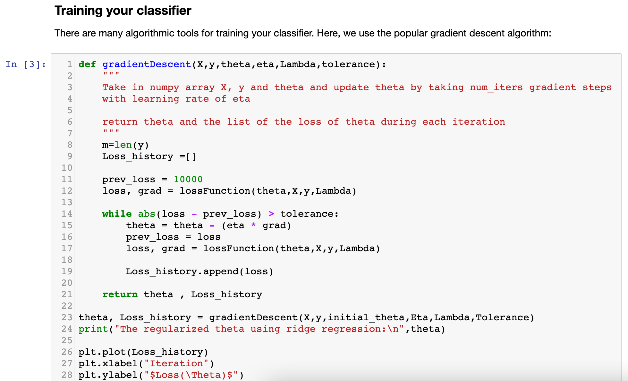
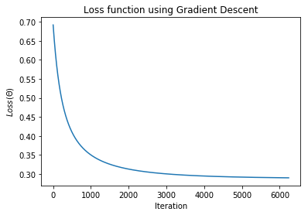

Slide 9
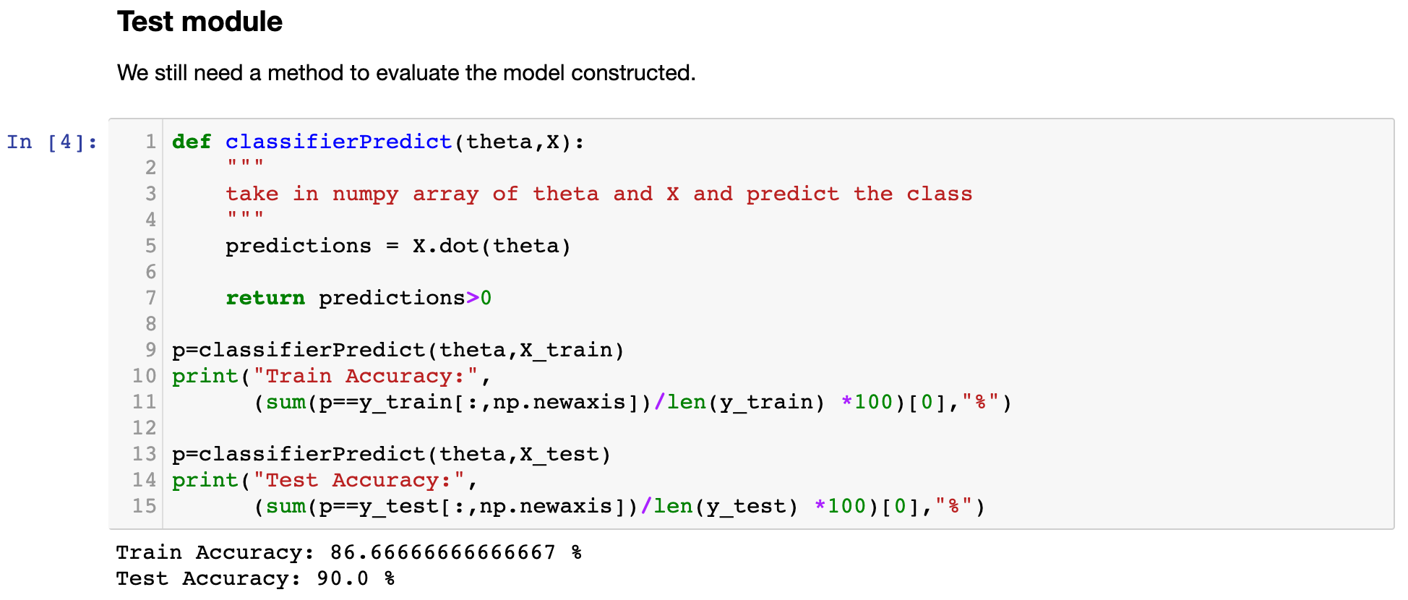

Slide 10
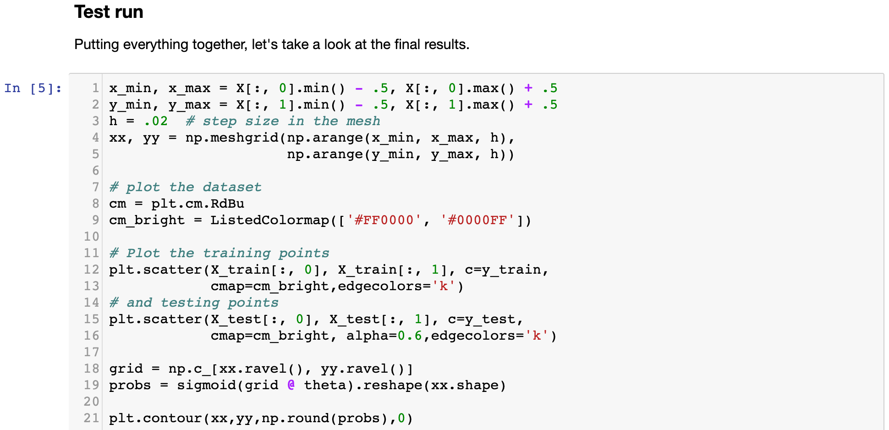
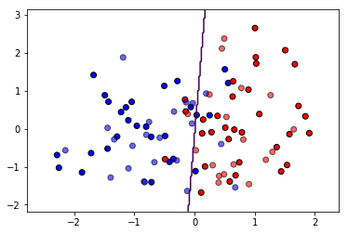
Demo of a Simple ML Pipeline: Try it out!

